Slide 1
Calorie restriction: risks and benefits
Sven Bulterijs
This presentation is a primer for grass-roots discussion among young scientists. Nothing herein must be used as teaching material or as a source for scientific information. The presenters comments and views are purely his own and may not be taken as scientific or medical advice and do not reflect the position of any other scientist or institution.
Pictures and graphics used in this non-profit educational presentation are included under ‘fair use’ provisions, without challenge to existing copyright. If you hold the copyright to any pictures used here and object to their use, please notify the author and the picture will be removed.

Slide 2
Benefits

Slide 3
Life span extension: obviously
E. coli, yeast, water striders, rotifers, C. elegans, mosquitos, Drosophila, spiders, mice, rats, hamsters, guinea pigs, fish, and dogs
Increase in survival in monkeys
But not in: Musca domestica (house fly), Ceratitis capitata (Mediterranean fruit fly), Speyeria mormonia (Mormon Fritillary), and in some water striders (Gerris sp.) and rotifers

Slide 4
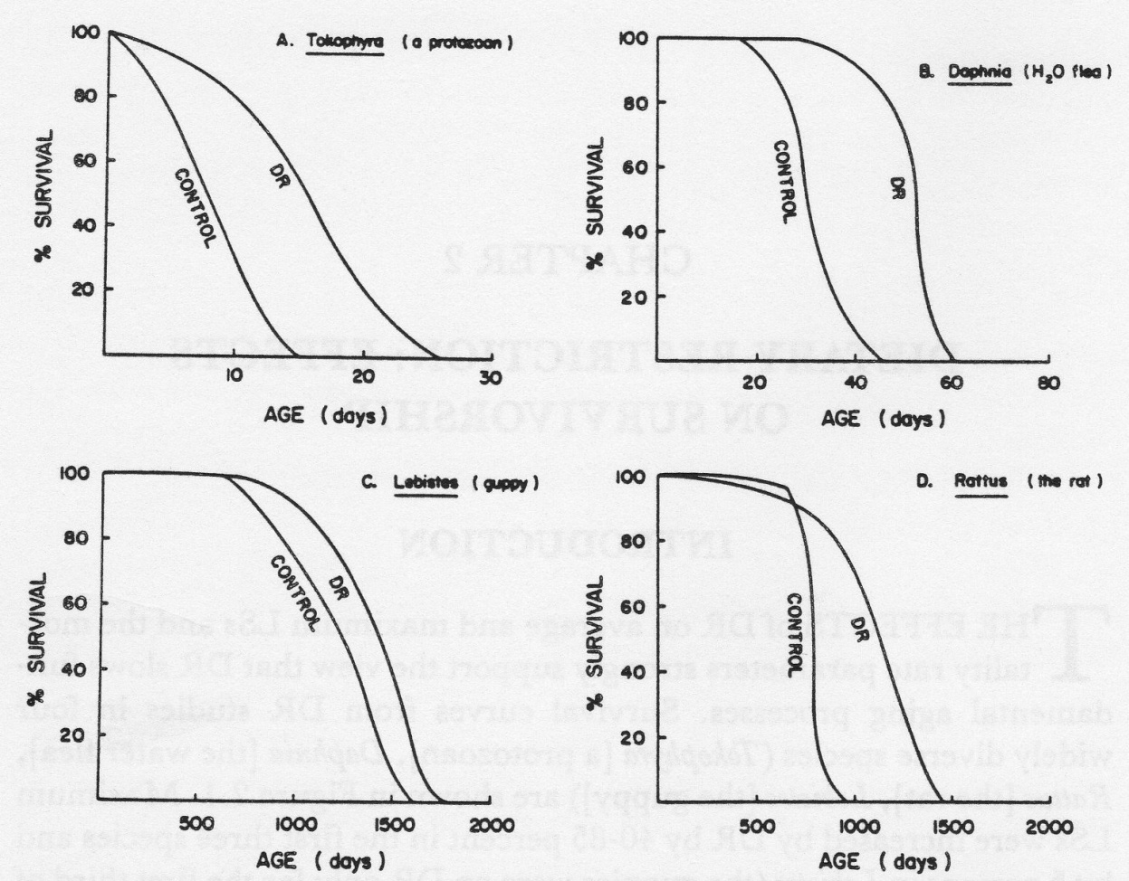
Life span extension: obviously
From: Weindruch and Walford, Charles C Thomas, Springfield, 1988

Slide 5
Insulin resistance
Type 2 diabetes: 20% of Americans aged 60 to 75
CR restored hepatic insulin sensitivity in 18 month old rats to levels of 4 month old
Reason: CR decreases visceral fat (VF)
Surgical removal of VF improved hepatic insulin action by more than 2-fold
Quick improvement in insulin sensitivity after gastric bypass (often within 10 days)
In obese people 8 weeks of severe CR (600 kcal/day) reversed type 2 diabetes

Slide 6
Cardiovascular disease
Mortality from CAD decreased during WWII
Decrease in diastolic and systolic blood pressure, LDL, triglycerides, total cholesterol, glucose, glycated hemoglobin, and C-reactive protein
HDL: decreased in a small sample size study but increase in a bigger one
CR also protects against cardiomyopathy
In a rat model of myocardial infarction the size of the infarct was 2-fold smaller in intermittent fasting (IF) animals

Slide 7
Cancer
In 1909: inhibition of growth of transplanted tumors
Also inhibition of spontaneous tumor incidence, chemically and radiation-induced tumors
For example in (Begga et al., 1995) 40% CR resulted in a decrease in breast tumor incidence (63-68% vs 21%), tumor burden (1.84-2.05 vs 0.37-0.43 tumors/rat), and tumor weight (7.1-11.9 vs 1.4-2.2g)
Short term fasting protects healthy cells but not cancer cells against toxicity of chemotherapy (when LID mice where given doxorubicin none of the AL animals survived but 60% of the fasting survived)

Slide 8
Memory function
Delays age-related declines in psychomotor and spatial memory tasks in mice
CR appeared to attenuate age-related alterations in some parts of the white matter in the brain.
Improves memory function
in elderly humans
Less iron accumulation
might partially explain
these benefits.
PNAS, 2009, 106: 1255-1260

Slide 9
Alzheimer’s disease
5.3 million cases in the US
Decrease in Aβ1-40 and Aβ1-42 in the temporal cortex of Squirrel monkeys
Prevents neuritic plaque formation in Tg2576 mice

Slide 10
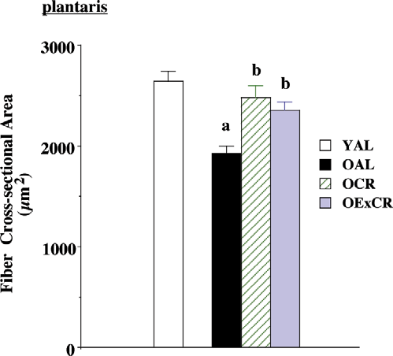
Sarcopenia
Lifelong mild (8%) caloric restriction retards age-induced changes in fast-twitch muscle (plantaris) morphology including fiber atrophy, increased extramyocyte space, and accumulation of connective tissue
Exp Gerontol, 2008,
43: 317-329

Slide 11
Autoimmune disease
Reduced autoimmune disease in normal and autoimmune prone (NZB, (NZB x NZW)F1, MRL/Mp-lpr/lpr, BXSB, and kd/kd) mice
Mechanism: CR reduces proliferation rate of lymphoid cells of the thymus, spleen, and mesenteric lymph nodes

Slide 12
Risks

Slide 13
Hunger
Restricted animals show signs of hunger
Hunger depends on diet composition → low calorie-dense diet
A cross-sectional survey of 7356 adults in the US shows that those with a low energy-density diet had lower energy intakes even though they consumed more food by weight
However, the feeling of hunger itself might have health benefits. Hunger is caused by ghrelin but ghrelin also promotes memory and neurogenesis, inhibits NFκB, and improves immune function

Slide 14
Osteoporosis
CR causes bone loss and a decrease in bone mineral density in rodents and humans
35% CR in humans for between 3 and 20 years does not decrease bone quality

Slide 15
Susceptibility to infections
CR in general has a beneficial effect on molecular and cellular immune-function
Only 3 studies with intact pathogens so far!
Moderate-term CR has little effect on death rate after bacterial, viral, and nematode infection while long-term CR increases the death rate
Anorexia nervosa (AN) patients stay free from infections until late in the disease

Slide 16
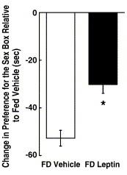
Libido
Low libido has been reported in people who undergo voluntary calorie restriction or semi-starvation
Personal observation: this does not seem to occur in very young people
Low libido is caused by low hormone levels (leptin and testosterone) and
psychological stress
Leptin administration attenuated
the food restriction-induced
reduction in sex in female Syrian
hamsters
Schneider et al. Horm Behav 2007; 51: 513-27

Slide 17
Fertility
CR increases age of sexual maturation
Fertility is reduced in rodents under CR
During starvation (WWI and II, anorexia nervosa): amenorrhoea (= absence of a menstrual period in a woman of reproductive age)
After returning to AL intake the reproductive performance is increased
40% CR protected egg cells from age-related increases in aneuploidy, chromosomal misalignment on the metaphase plate, meiotic spindle abnormalities and mitochondrial dysfunction

Slide 18
Amyotrophic lateral sclerosis
No benefit from CR on disease onset and progression in a SOD^{G93A} mice model (1999)
CR shortens life span of SOD^{G93A} mice model (2010)
Metformin (CR mimetic) has no benefit and is even disadvantageous in female SOD^{G93A} mice (2011)

Slide 19
References
Speakman JR, Mitchell SE. Caloric restriction. Mol Aspects Med 2011 [in press].
Spindler SR. Caloric restriction: from soup to nuts. Ageing Res Rev, 2010, 9: 324-53.
Mair W, Dillin A. Aging and survival: the genetics of life span extension by dietary restriction. Ann Rev Biochem 2008; 77: 727-54.
Merry BJ. Molecular mechanisms linking calorie restriction and longevity. Int J Biochem Cell Biol 2002; 34: 1340-54
Longo VD, Fontana L. Calorie restriction and cancer prevention: metabolic and molecular mechanisms. Trends Pharmacol Sci 2009; 31: 89-98.
Fontana L, Partridge L, Longo VD. Extending healthy life span—from yeast to humans. Science 2010; 328: 321-8.
Holloszy JO, Fontana L. Caloric restriction in humans. Exp Gerontol 2007; 42: 709-12.

